Slide 1
Foveated Rendering
Team Fovea
Notes:
Arjun

Slide 2
Team Members
Dietrich Kruse
Mallikarjun Edara
Scott McElfresh
Notes:
Arjun

Slide 3
The Problem
There is a considerable amount of research being done to reduce the computational cost of rendering, especially in video games. For instance, Nvidia released their Deep Learning Super Sampling (DLSS) technology in 2020.
DLSS uses machine learning to upsample a low resolution frame to a higher resolution like 4k or 8k. Nvidia boasts insane performance increases (+70% in Call of Duty: Warzone) when using DLSS.
In terms of VR/AR/XR, the devices must render the same image twice (one for each eye) per frame. High performance PC’s have the capabilities to render these, but for XR to reach mass adoption standalone devices will need to be able to render the same level of graphics without connection to a computer.
Team Fovea focused on a technique called Foveated Rendering to increase rendering performance.
Notes:
Dietrich

Slide 4
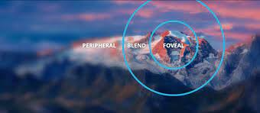
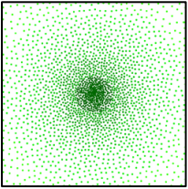
What is Foveated Rendering?
Our eyes only render what the center of the retina, or the fovea, is pointed at in full resolution. The rest of your vision is mostly generated by the brain.
Foveated rendering is a technique that applies the same theory to the rendering process, reducing the rendering workload.
Notes:
Arjun

Slide 5
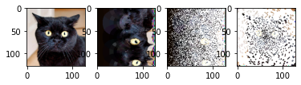
How does it work?
Original Image
Generate a sparse density pixel distribution centered around a specific point (center of screen for this project).
Train autoencoder on sparse images vs. original images
Predict output image from sparse input
Notes:
Arjun

Slide 6
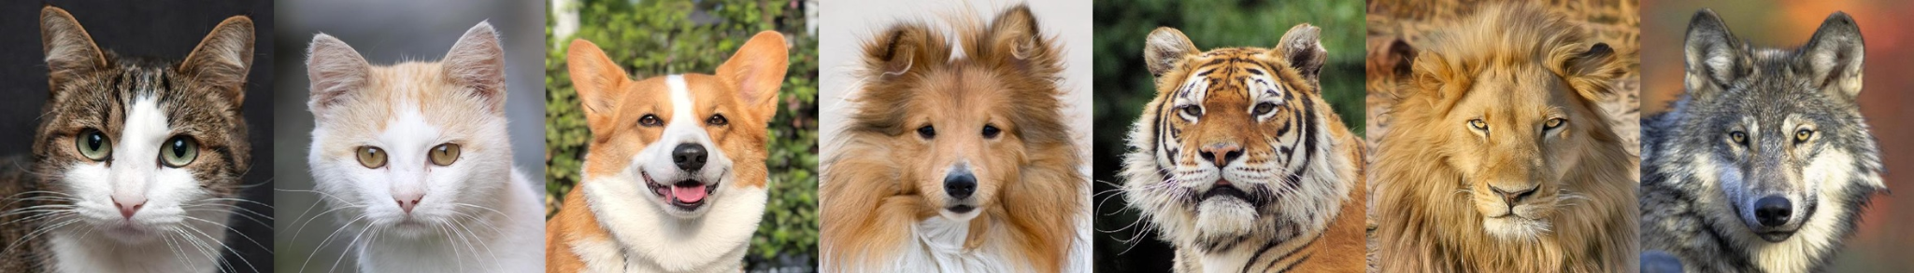
Dataset
The team used the cat directory of the Animal Faces library from Kaggle.
https://www.kaggle.com/andrewmvd/animal-faces

Slide 7
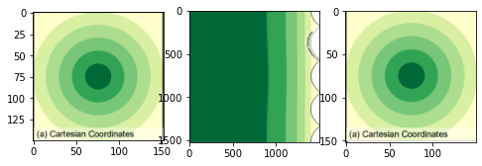
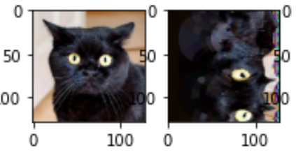
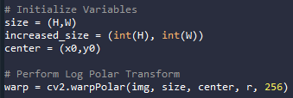
Image Conversion
To generate our compressed image, we first perform a Log-Polar conversion on our image from our image cartesian coordinates. This simulates a fovea at the center of our image.
Notes:
Dietrich

Slide 8
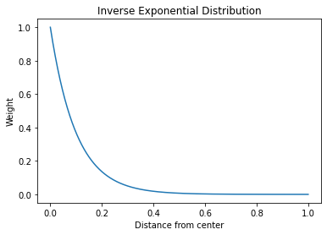
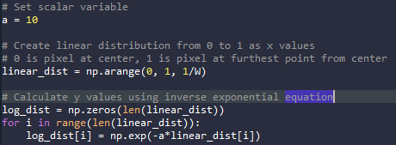
Pixel Density Distribution
After the Log-Polar conversion, the pixel density distribution will be created using an inverse exponential distribution to assign density values to each column of the warped image.
Notes:
Dietrich

Slide 9
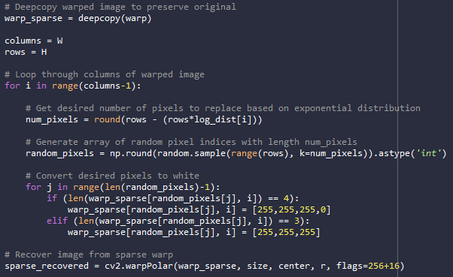
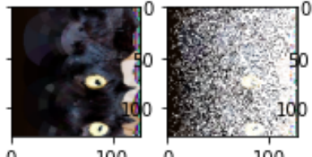
Applying Distribution to Image
Once the density distribution has been calculated, it is applied to the image by looping through each column of the warped image and setting a certain number of pixels to a new color (originally white).
Image prediction/generation was incorporating the white into the generated images. To account for this, a random color from the image color space was applied to the selected pixel distribution.

Slide 10
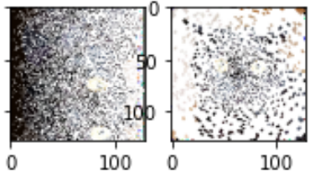
Converting Image from Polar to Cartesian
Finally, the image must be transformed back to the cartesian coordinate system for use in the model.

Slide 11
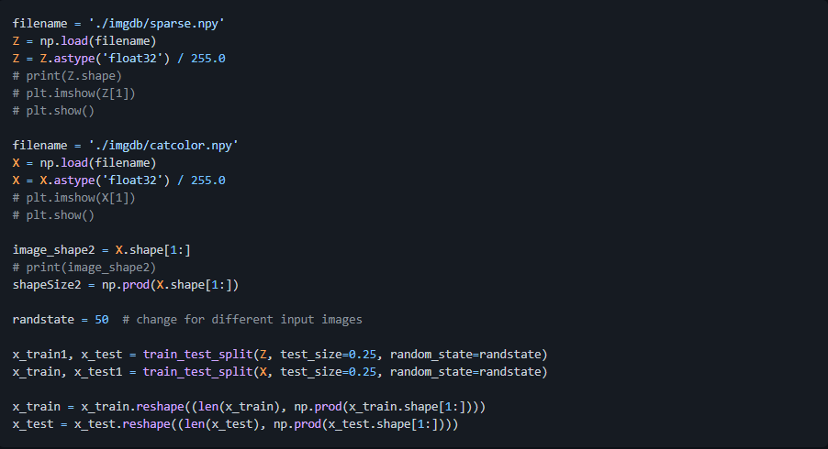
Dataset Preparation
Once the dataset has been imported and sparse versions of each image have been created, they are normalized by dividing by 255.0. The database is then split into 75%/25% training/testing batches and reshaped into a single array.

Slide 12
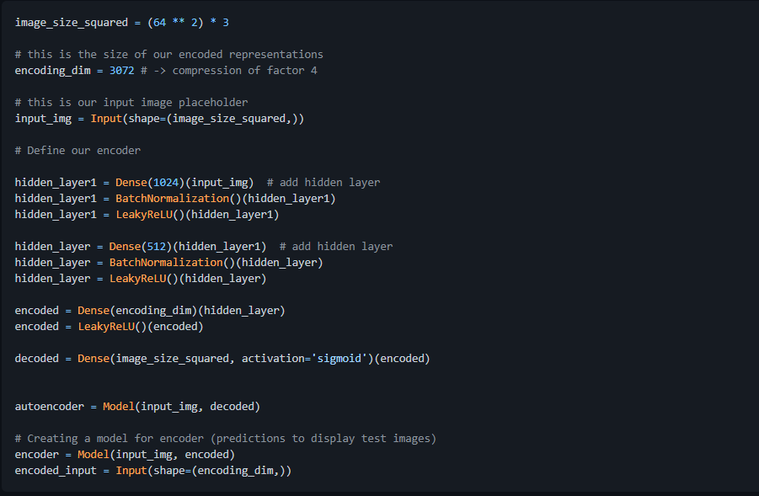
Encoder
A compression factor of 4 was used for the input images to compress them from a size of 12288 to 3072 pixels.
The encoder has an initial input of 1024 neurons in a Dense layer and bottlenecks to a Dense layer with 512 neurons.
Each hidden layer also includes a batch normalization and uses Leaky Relu activation. Batch normalization greatly improved our image color range and contrast output and also decreased training time (the model stabilizes around 80 epochs).

Slide 13
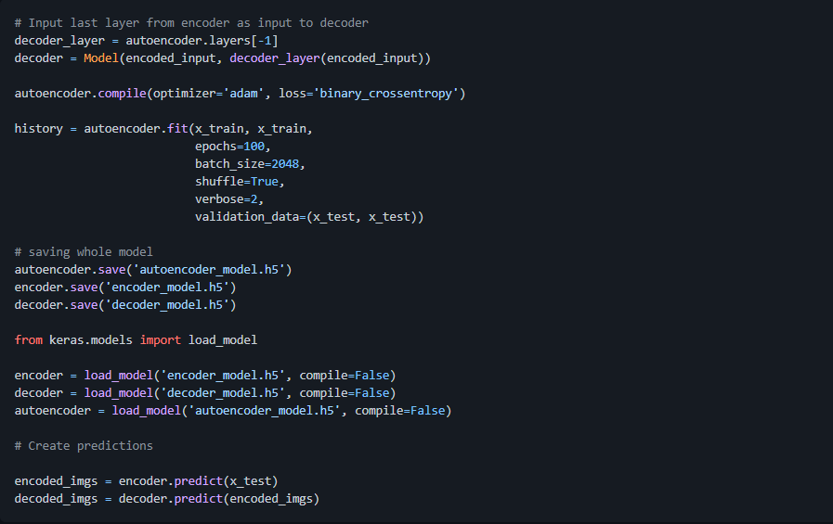
Decoder
The decoder was created with a single Dense layer that takes the last layer of the encoder as input.
Decoder complexity was experimented with, however the images that were generated had less clarity.
Finally, the model was trained with 100 epochs and a batch size of 2048
Later, after experimentation with batch sizes, it was foua batch size of 128 yielded images which were less blurry and thus more similar to the source image

Slide 14
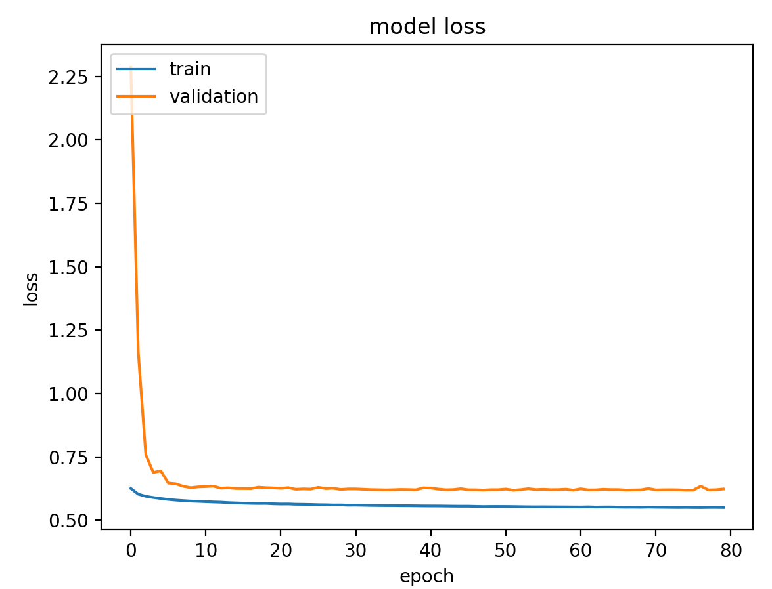
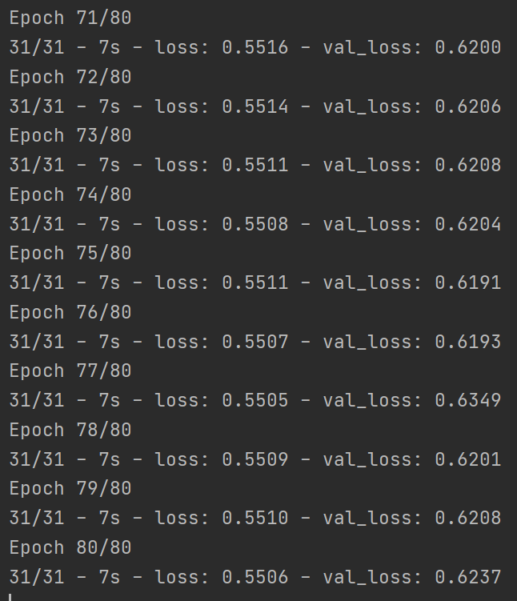
Model Loss Plot

Slide 15
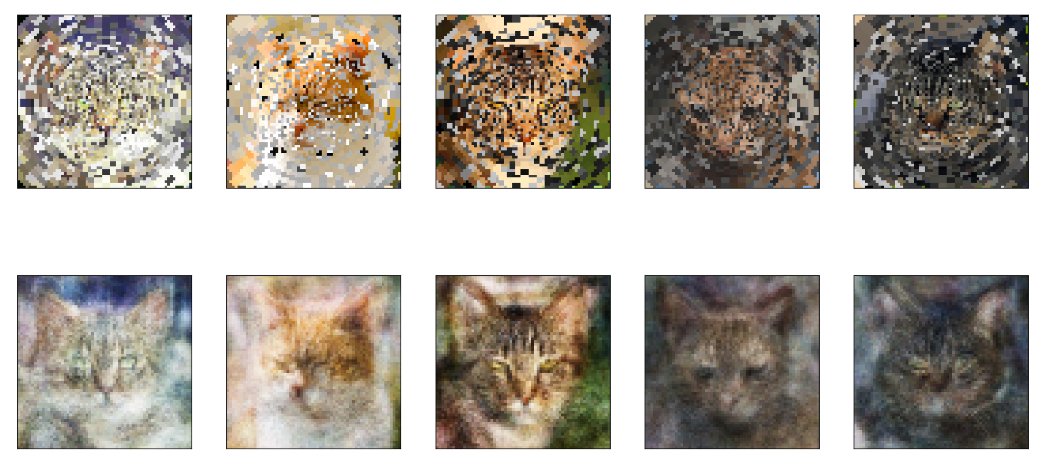
Results

Slide 16
Conclusions/Future Work
Overall, the results are decent. The output images could be more clear, and we think results could be improved in several ways:
A larger dataset is always helpful.
The use of a Generative Adversarial Network may produce better results, especially when combined with machine learning in-painting techniques.
In terms of Future Work, the model could be combined with an AI Eye Tracking system to render only the portion of the image the user is looking at in full resolution. The following Shadertoy [Meng, https://www.shadertoy.com/view/lsdfWn] is a good representation of the full scope of Foveated Rendering, although it uses a different method than machine learning.

Slide 17
Current work distribution
ARJUN: Research and GitHub Maintenance
DIETRICH: Image transformation and sampling
SCOTT: GAN and Autoencoder research and development

Slide 18
GITHUB
GITHUB: https://github.com/sme1d1/Foveated_Rendering
Increment 3 Wiki:
https://github.com/sme1d1/Foveated_Rendering/wiki/Increment3---Code-Review

Slide 19
VIDEO
https://youtu.be/sk8KLYn9ua0

Slide 20
REFERENCES
Brownlee Jason. 2019. How to develop a generative adversarial network for an minst handwritten digits from scratch in keras. Am J Vet Res. 62(11):1812–1817.
(Jason Brownlee 2019)
Cheuk Yiu Ip, Adil M¸David L, Amitabh V. 2009. PixelPie: Maximal Poisson-disk Sampling with Rasterization.Nvidia Research. 9(1):49–58.
(Cheuk et al. 2009)
Brownlee Jason. 2019.A Gentle introduction to Generative Adversarial Networks(GANs). Am J Vet Res. 62(11):1812–1817.
(Jason Brownlee 2019)
Brownlee Jason. 2019.How to Train a Progressive Growing GAN in Keras for Synthesizing Faces. Am J Vet Res. 62(11):1812–1817.
(Jason Brownlee 2019)
Anton S. K, Anton S, Thomas L , Mikhail O, Todd G, and Gizem R.DeepFovea: Neural Reconstruction for Foveated Rendering and Video Compression using Learned Statistics of Natural Videos.Facebook Reality Labs
(Anton et al.2019)
Meng, Xiaoxu. 2018. Kernel Foveated Rendering. University of Maryland, College Park

